Slide 1
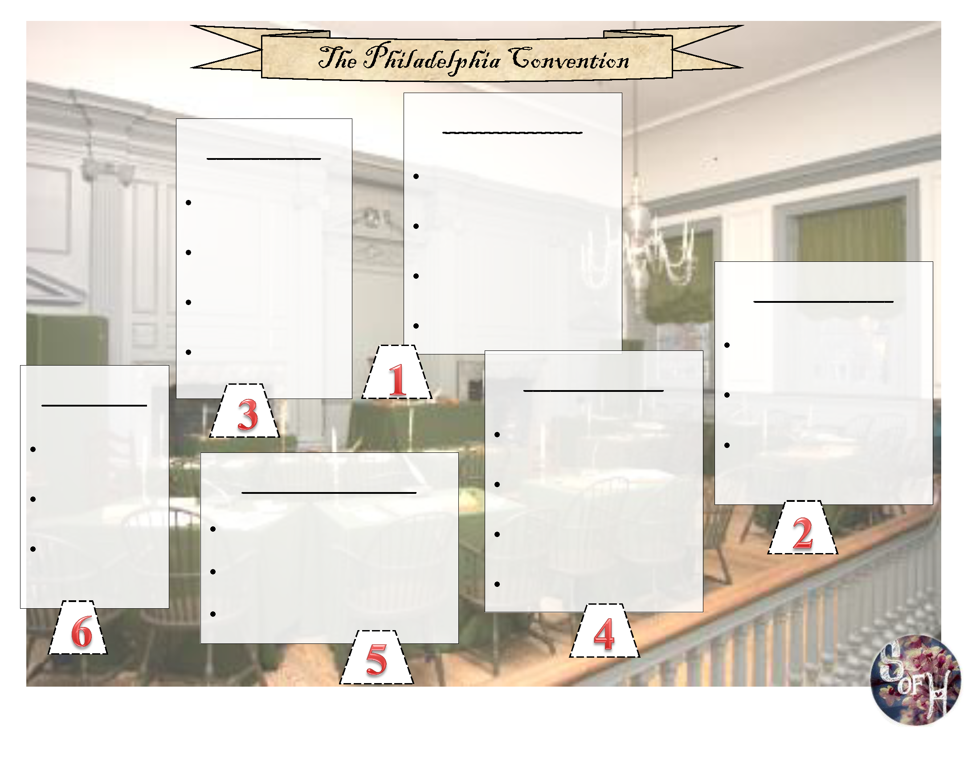
Notes:
Printable graphic organizer to print for students before class and distrubute.

Slide 2
Notes:
Printable pop up figures. Print before class and distribute one to each student

Slide 3
Notes:
Teacher’s copy/answer key for your convenience or to supply to absent students.

Slide 4
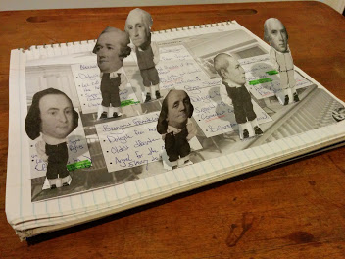
Completed Student Sample

Slide 5
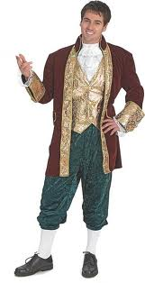
It’s 1787, and some of our founders are hanging out at a tavern the night before the Constitutional Convention. Use your notebook to answer these questions…
What are some changes they want to make to the Articles of Confederation?
What are some potential arguments they might get into when creating a new government?
How do you think they solved some of their arguments?

Slide 6
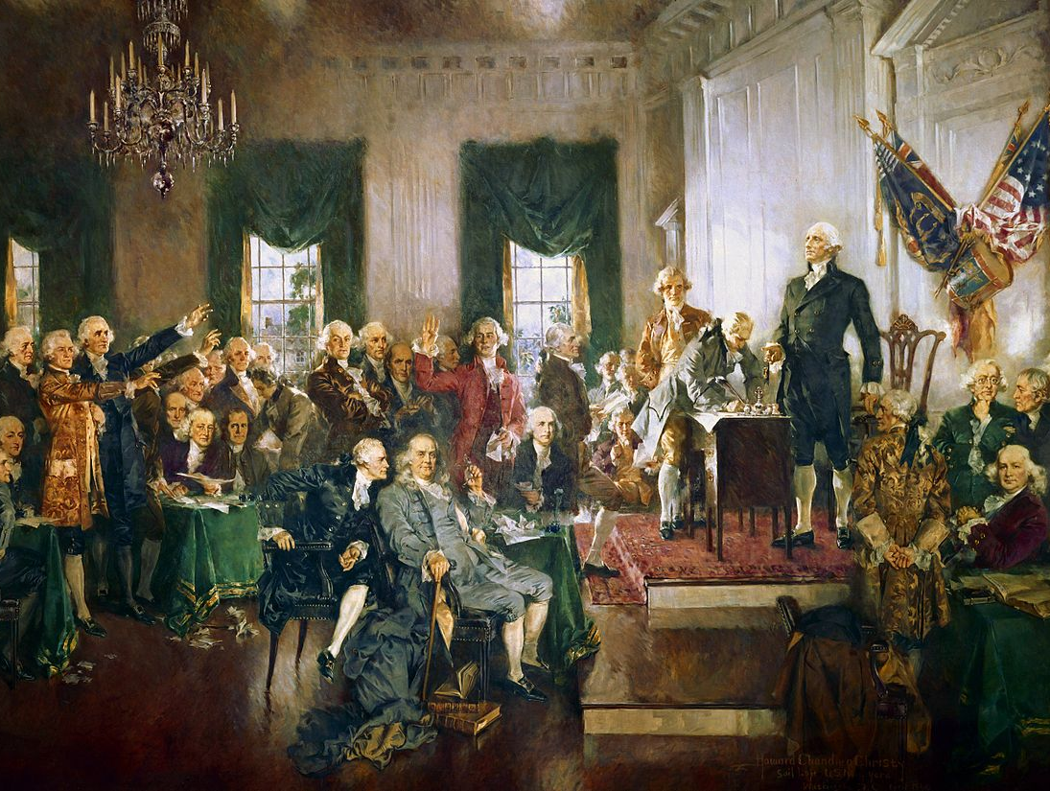
http://www.teacherspayteachers.com/Store/Students-Of-History/

Slide 7
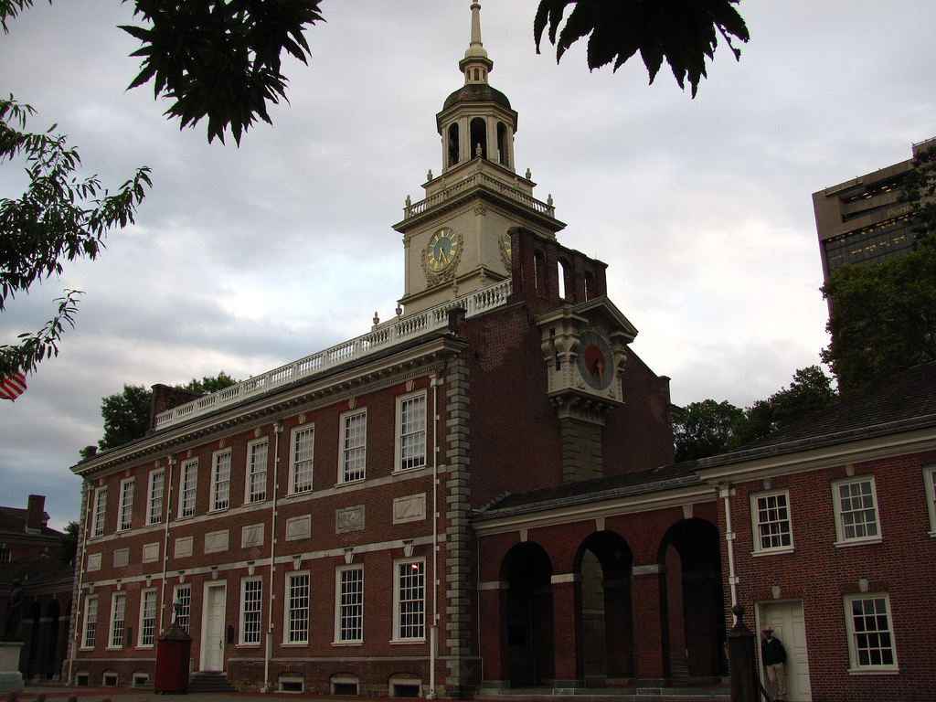
The Articles of Confederation are determined to be too weak
A convention is held in Philadelphia in 1787
The delegates decide to create a new government rather than fix the Articles

Slide 8
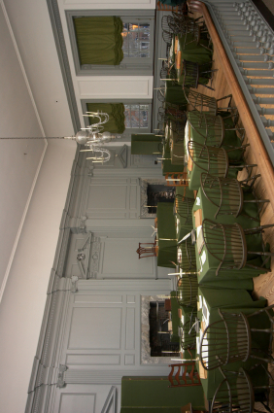

Slide 9
Delegate from Virginia
Elected president of the Convention
Spoke little but commanded respect due to his experience
His support for ratification was instrumental

Slide 10
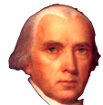
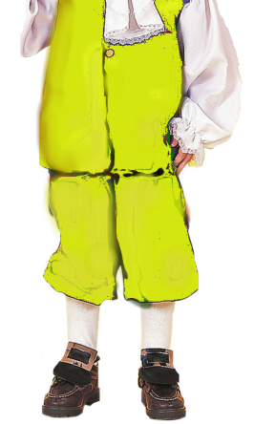
Delegate from Virginia
Called the “Father of the Constitution”
Author of the Virginia Plan which became the blueprint for the Constitution

Slide 11
Delegate from New York
Led call for to replace the Articles of Confederation
Supported a strong central government
Wrote many of the Federalist Papers calling for ratification
http://www.teacherspayteachers.com/Store/Students-Of-History/

Slide 12
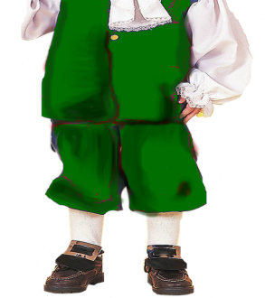
Delegate from Pennsylvania
Oldest delegate at the Convention
Argued for the abolition of slavery
Unhappy with parts but “doubted anyone could make a better Constitution.”

Slide 13
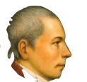
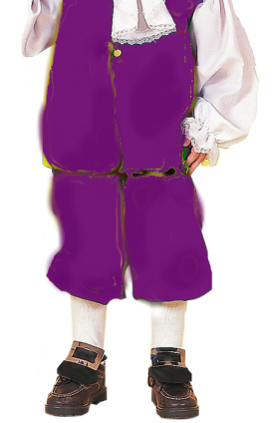
Delegate from Connecticut
Supported the Connecticut Compromise of a bicameral legislature
One of only 2 men to sign the Declaration of Independence, Articles of Confederation, & the Constitution
http://www.teacherspayteachers.com/Store/Students-Of-History/

Slide 14
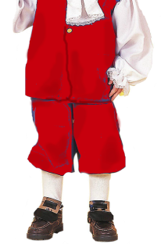
Delegate from Virginia
Refused to sign the Constitution until a Bill of Rights was added
The Bill of Rights was eventually based on Mason’s Virginia Declaration of Rights
http://www.teacherspayteachers.com/Store/Students-Of-History/

Slide 15
The Constitution established a government that shared power between the national and state governments, protected the rights of states, and provided a system for orderly change through amendments to the Constitution itself.
How can the Constitution be changed?
Why is it important to share power between the National government & states?
lukerosa@gmail.com

Slide 16
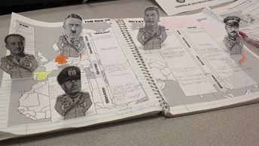
Thank you so much for your purchase!
Please visit my store for more great Social Studies resources – including more Magic Portraits, Daily Warm Ups, PowerPoints in 3D, Interactive notebook Pop-Ups, Reading guides, Unit Plans, and more!!!
http://www.teacherspayteachers.com/Store/Students-Of-History

