Slide 1

Notice and Note
Signposts

Slide 2
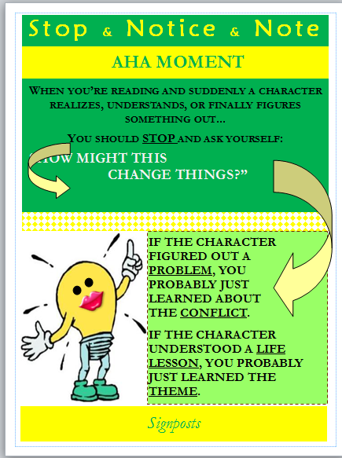

Slide 3

Aha Moment
Aha Moments are moments when a character realizes something, and that realization will probably change his or her actions in some way.
Clues that an Aha Moment is coming:
“Suddenly I realized…”
“In an instant I saw…”
“It came to me in a flash…”
“I finally understood that…”

Slide 4
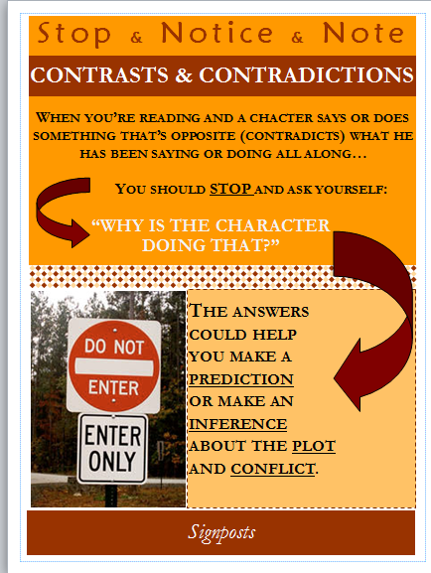

Slide 5

Contrasts and Contradictions
When authors show us something that doesn’t fit with what we expect, when they present us with a contrast or a contradiction.
We want to pause and ask ourselves one question: Why would the character act this way?

Slide 6
Video Activity for Contrast and Contradictions
http://www.youtube.com/watch?v=jlb0D9YHR7Y
As You watch the clip from Tangled, look for places where a character’s actions surprise you. A character can act a certain way that is unexpected.
Whenever this contradiction occurs make a note on your worksheet about who is making the contradiction and why you think they aren’t acting the way they usually act.

Slide 7
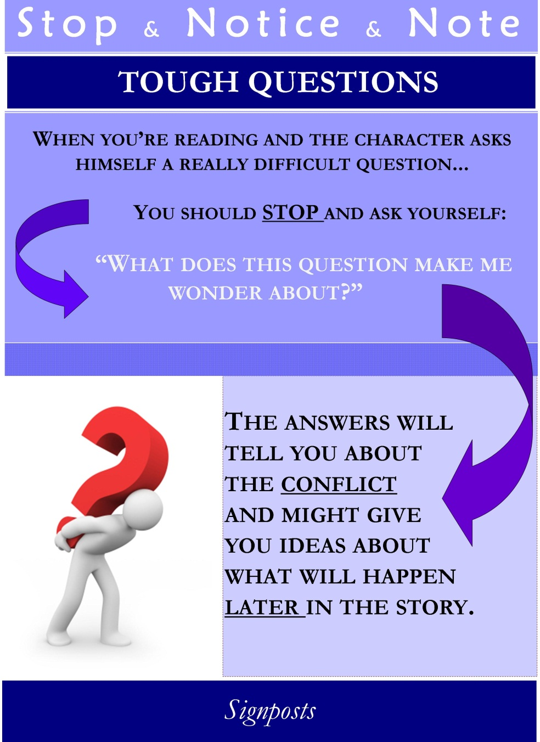

Slide 8
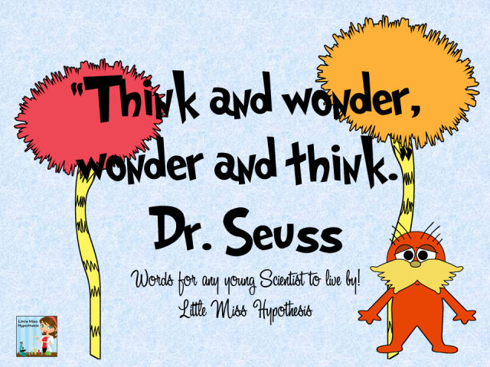
Tough Questions
When you’re reading and the character asks himself a really difficult question…
We want to pause and ask ourselves one question: “What does this question make me wonder about?”

Slide 9

Tough Questions Film Activity
http://www.youtube.com/watch?v=TFhLU7ULTtA
What is the tough question the character asks himself? What does that question make you wonder about him and his life? Remember that the answer will tell you about the conflict.
2. What is the conflict in the story?
3. What do you think will happen later in the story?

Slide 10
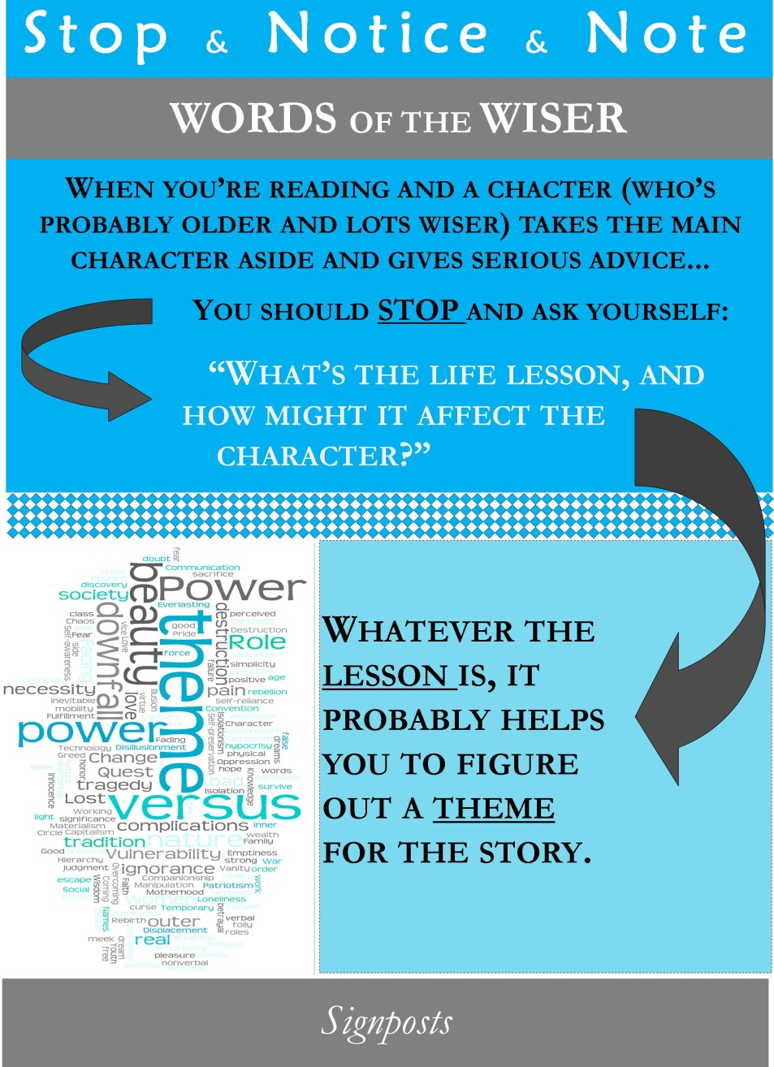

Slide 11

Words of the Wiser
When you’re reading and a character (who’s probably older and lots wiser...but not ALWAYS older…) takes the main character aside and gives serious advice, you should stop and ask yourself…
…What’s the life lesson, and how might it affect the character?
  (P.S. Whatever the lesson is, you’ve probably found a theme for the story.)

Slide 12
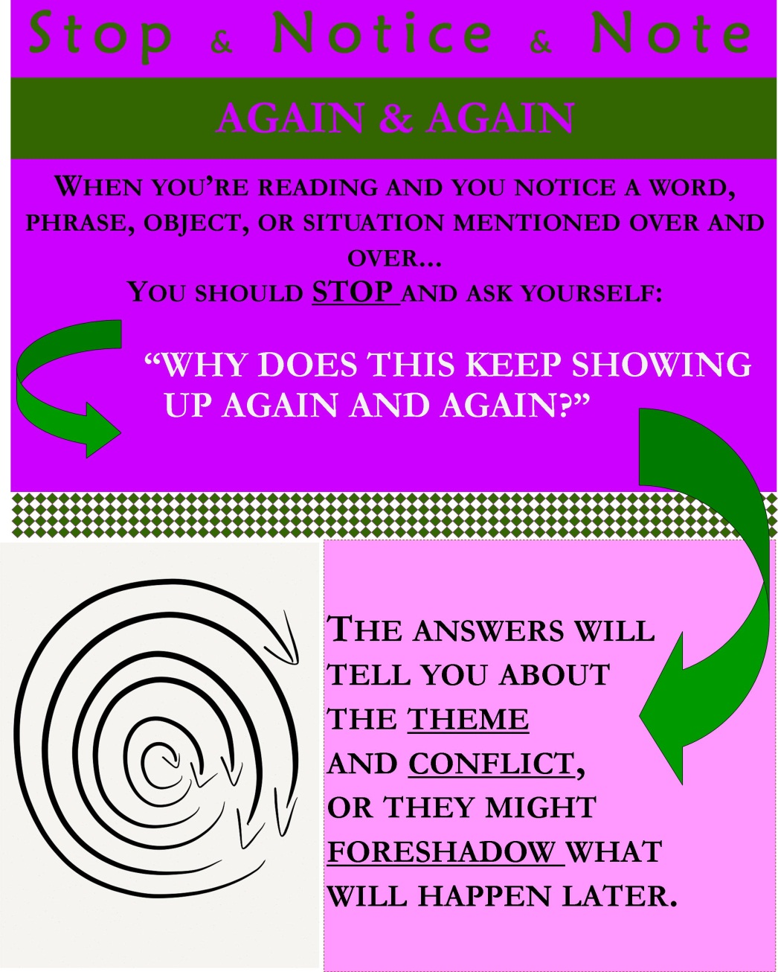

Slide 13

Again & Again
When you’re reading and you notice a word, phrase, object, or situation mentioned over and over, you should stop and ask yourself…
…Why does this keep showing up again and again?
(P.S. The answers will tell you about the theme and conflict, or they might foreshadow what will happen later.)

Slide 14
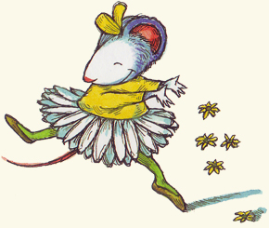
Again and Again Picture Book Activity
Picture Book: Chrysanthemum
Make a list of all the words repeated in this book. Now, think of events that are repeated. Next, ask yourself, “Why does this keep showing up again and again?”
What does that tell you about the theme of the book?

Slide 15
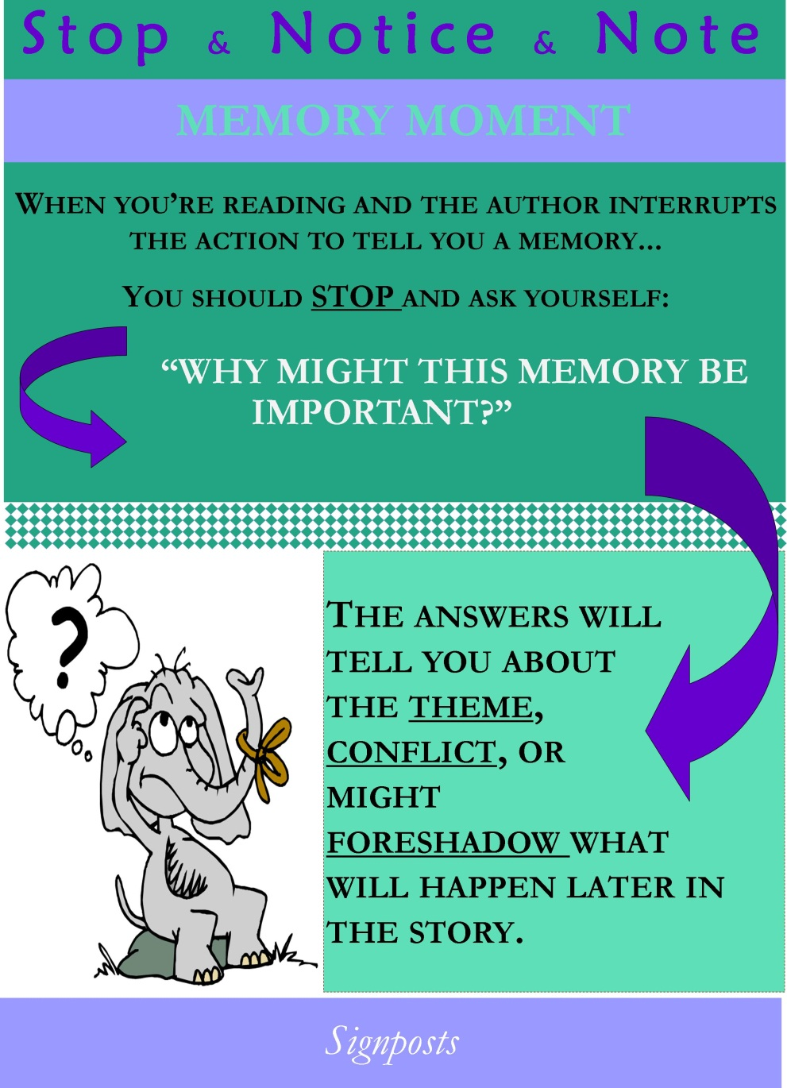

Slide 16

Memory Moment
When you’re reading and the author interrupts the action to tell you a memory, you should stop and ask yourself…
…Why might this memory be important?
(P.S. The answer will tell you about the theme, conflict, or might foreshadow what will happen later in the story.)

